Slide 1


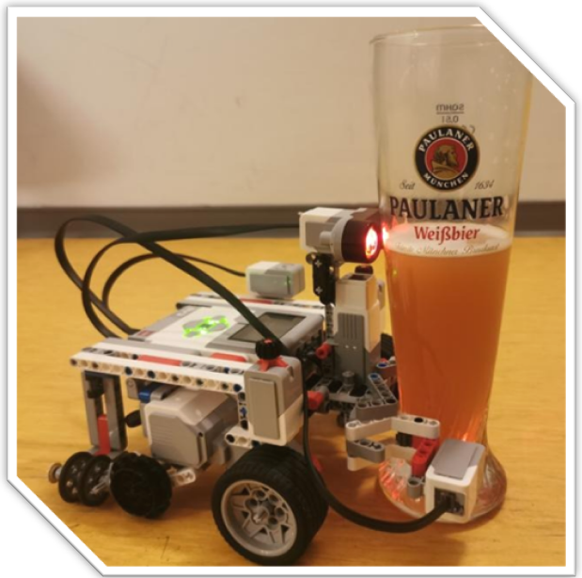
Sprint Review
Lasting, efficient and fast bots
Product owner:
ENCARNACIÓN NÚÑEZ ORTEGA
SCRUM master:
LAURA PONCE OROZCO
Development team:
LAURA PONCE OROZCO
ENCARNACIÓN NÚÑEZ ORTEGA
FERLANDO MKIVA
Notes:
We updated a new product owner.

Slide 2

User stories in this sprint
As a user, I want the robot to ask me for the correct fruit and to confirm that it understood me.
As a user, I want the robot to look for the specified fruit and check if the fruit is correctly grabbed.
As a developer, I want the robot to be able to detect a 2.5cm cube.

Slide 3

Velocity chart
8
Planned effort
Actual effort
12
8
4
0
4
Expected
Done
Changes
SPRINT 1
SPRINT 2
SPRINT 3

Slide 4
Team’s velocity
8
Look for the specified fruit and check if the fruit is correctly grabbed
Ask for the correct fruit and confirm that it understood it.
5
2
Sprint
Review
Detect a 2.5cm cube.
1

Slide 5
Burn-down charts
8
7
6
5
4
3
2
1
0
28
24
20
16
12
8
4
0
COFFEES
COFFEES
1 2 3 4 5 6 7
1 2 3
DAYS
SPRINTS

Slide 6
Incomplete user story
Complete work:
Robot looks for any fruit.
Incomplete work:
Robot looks for a specific fruit.
Robot grabs the fruit correctly.
As a user, I want the robot to look for the specified fruit and check if the fruit is correctly grabbed.
Notes:
We couldn’t complete this user story, because we only made the robot to look for a fruit.

Slide 7
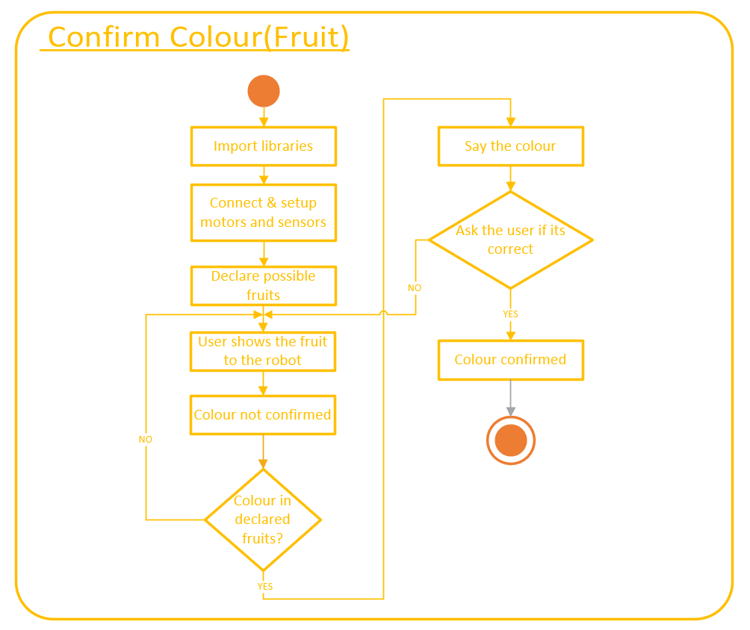
Activity Diagram
As a user, I want the robot to ask me for the correct fruit and to confirm that it understood me.

Slide 8
Activity Diagram
As a user, I want the robot to ask me for the correct fruit and to confirm that it understood me.

Slide 9
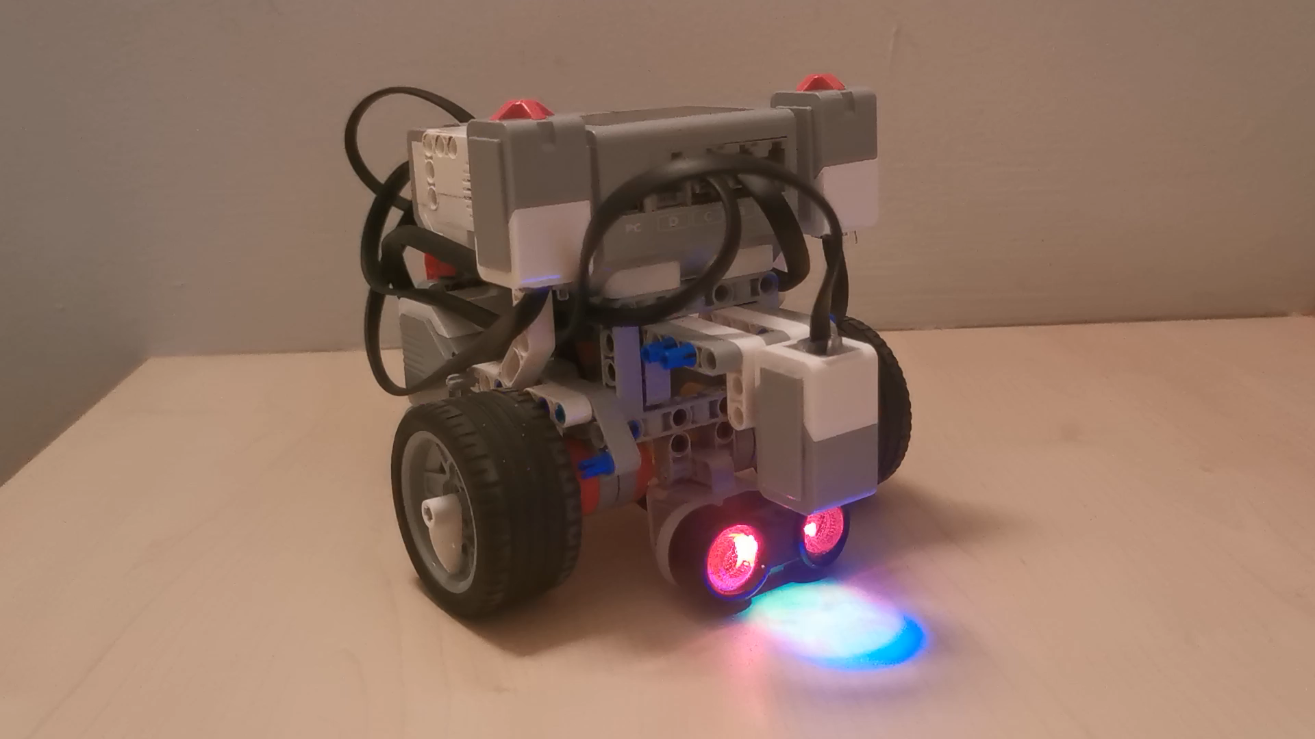
Demo

Slide 10
Retrospective
Highlight
One shared screen to work more efficiently.
Lowlight
Waste of time trying to implement different codes for the same task.
Notes:
Highlight
At first we worked separately, and then we realized that we work better in one screen, because we can all see the code at the same time and detect the errors.

Slide 11
SMART goal
Our goal is to work everyday in the project in order to accomplish more efficiency and less working hours in one day.
Accomplishing this goal will result in a healthier working environment and errors would be avoided by being fully concentrated while working.

Slide 12
Thanks!
Any questions ?
You can find me at
laura.ponce_orozco@student.reutlingen-university.de
ferlando.mkiva@student.reutlingen-university.de
encarnacion.nunez_ortega@student.reutlingen-university.de

